Slide 1
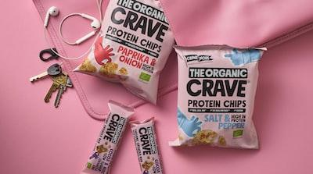
Project Nutrino Overview
Revolutionizing Online Food Delivery
The Problem Area: The growth of food delivery apps like Uber Eats has transformed the restaurant sector, offering vast choices but lacking in detailed health-focused specifications. Project Nutrino aims to fill this gap by using an API database to recommend dishes based on their macro nutrient profiles, catering to health-conscious consumers.
Target Audience: Focused on individuals aiming for a healthier lifestyle, Nutrino is designed to provide goal-specific food recommendations. It supports those on health and wellness journeys, integrating with online food delivery services to facilitate healthier choices.
The Big Idea: Nutrino will use users' dietary targets and current consumption to recommend dishes. Anticipating partnerships with health-centric brands, it's positioned to tap into the trillion-dollar health and wellness food market, offering a unique value proposition.
‎

Slide 2

Data Sources and Utilization
Powering Nutrino's Recommendations
Nutrionix Database: Utilizes the world's largest verified nutrition database, featuring over 100,000 ingrediants and dishes. It provides detailed macro nutrient profiles for each menu item, enabling precise dietary recommendations.
Food.com Database: An open database with over 520,000 home-cooking recipes, complete with macro tracking capabilities. This aids users in aligning their home-cooked meals with their dietary goals.
Local Restaurant & Grocery Store Data: Incorporates data scraped from the Google Maps API, offering a comprehensive view of local dining options. This helps in tailoring suggestions to users' geographical locations and dietary preferences.
‎

Slide 3
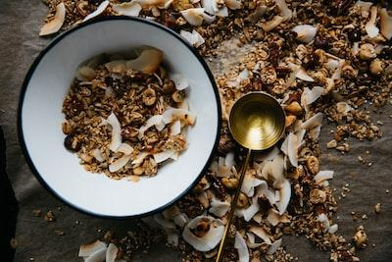
Data Preprocessing in Nutrino
Ensuring Accuracy and Consistency
Removing Incomplete Data: Recipes with missing serving counts were removed to guarantee the accuracy of macronutrient values per serving.
Standardizing Serving Sizes: All remaining recipes were standardized into single-serving portions, ensuring uniformity and easier comparison across different dishes.
Outlier Removal: Outliers were identified and excluded based on single-serving cutoff values determined by the American Food Association, refining the dataset for more reliable recommendations.
‎

Slide 4
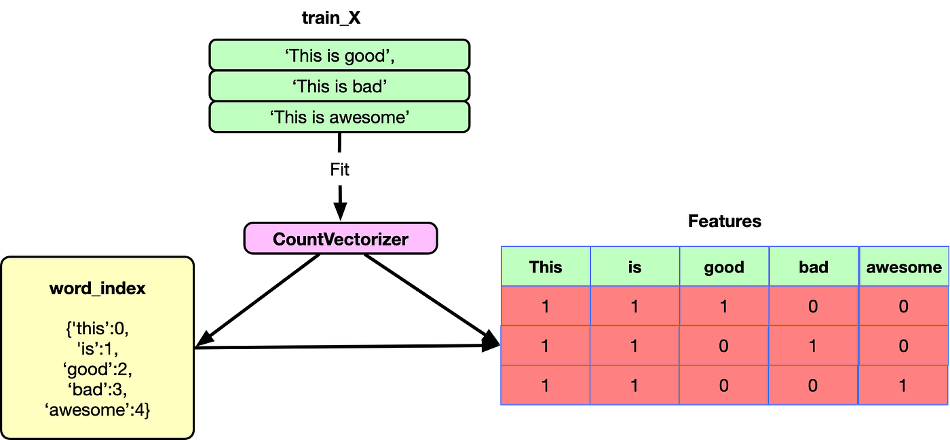
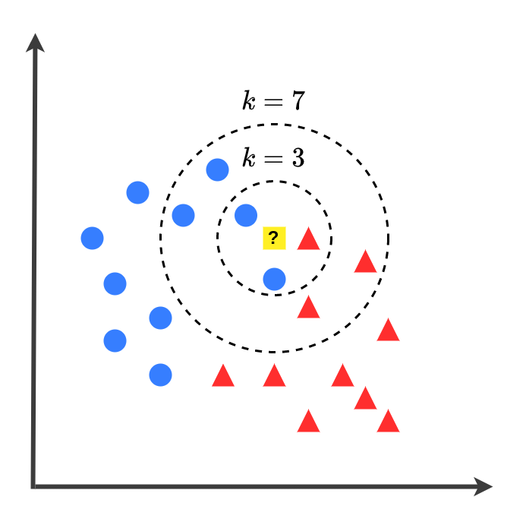
The Recommender Model
Advanced Techniques for Personalized Suggestions
TfidfVectorizer Usage: Nutrino employs TfidfVectorizer to analyze and isolate key ingredients and nutritional elements from each recipe. This technique transforms textual data into a numerical format, enabling more accurate matching of user preferences with dish characteristics.
Nearest Neighbor Model: Post-analysis, Nutrino utilizes a nearest neighbor model to identify and recommend dishes that closely align with the user's nutritional goals and preferences. This approach ensures highly personalized and relevant food suggestions.

Slide 5
Technology and User Experience
Navigating Nutrino's Interface
User-Centric Design: Nutrino features a user-friendly interface, allowing easy input of daily targets and tracking of consumed food. The app's design is intuitive, ensuring a smooth user journey from dietary input to dish recommendation.
Personalized Recommendations: Using advanced algorithms, Nutrino samples dishes in the user's vicinity and recommends options based on their dietary goals and preferences, enhancing the personalization of the health-focused dining experience.
‎

Slide 6



Product Demo Try it out!

